Slide 1
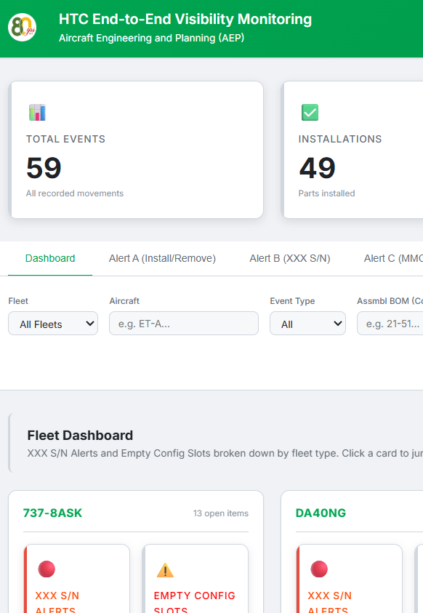
HTC End-to-End Visibility Monitoring
Extension of the Hard Time Configuration Slot Visibility Monitoring framework — adding automated alerts for part movement and serial number integrity.
PROJECT PROPOSAL
JUNE 2026
VERSION 1.0
Notes:
• Welcome everyone. Today I'm presenting a project proposal for HTC End-to-End Visibility Monitoring. • This is an extension of our existing Hard Time Configuration Slot Visibility Monitoring framework—we're building on what we already have in place. • The key enhancement: we're adding automated alerts for part movement and serial number integrity. • This addresses a critical gap in our maintenance operations—real-time visibility into component tracking and verification throughout the maintenance lifecycle. • This proposal is for June 2026 implementation, Version 1.0.

Slide 2
Executive Summary
Alert A — MMC
Alert B — XXX S/N
Weekly notification when an HTC part become MMC from any HT config slot.
Weekly alert when an HTC part with placeholder serial number 'XXX' is installed on a config slot.

Slide 3

Background & Origin
In March 2026, the MPTC team lacked visibility of newly created HT config slots in Maintenix. Required maintenance tasks were not always defined timely, creating compliance gaps.
Root Cause
No automated notification mechanism existed in Maintenix for HT slot creation events.
Corrective Action
Daily service email to ac-mp-engg@ethiopianairlines.com — implemented and confirmed operational by April 7, 2026.
RCCA Reference
RCCA No. 08-April-2026 | IT Ticket #6115802 | Team: Solomon Alemu, Dawit Negash, Pineal Dibaba, Birhanu Mossie.

Slide 4
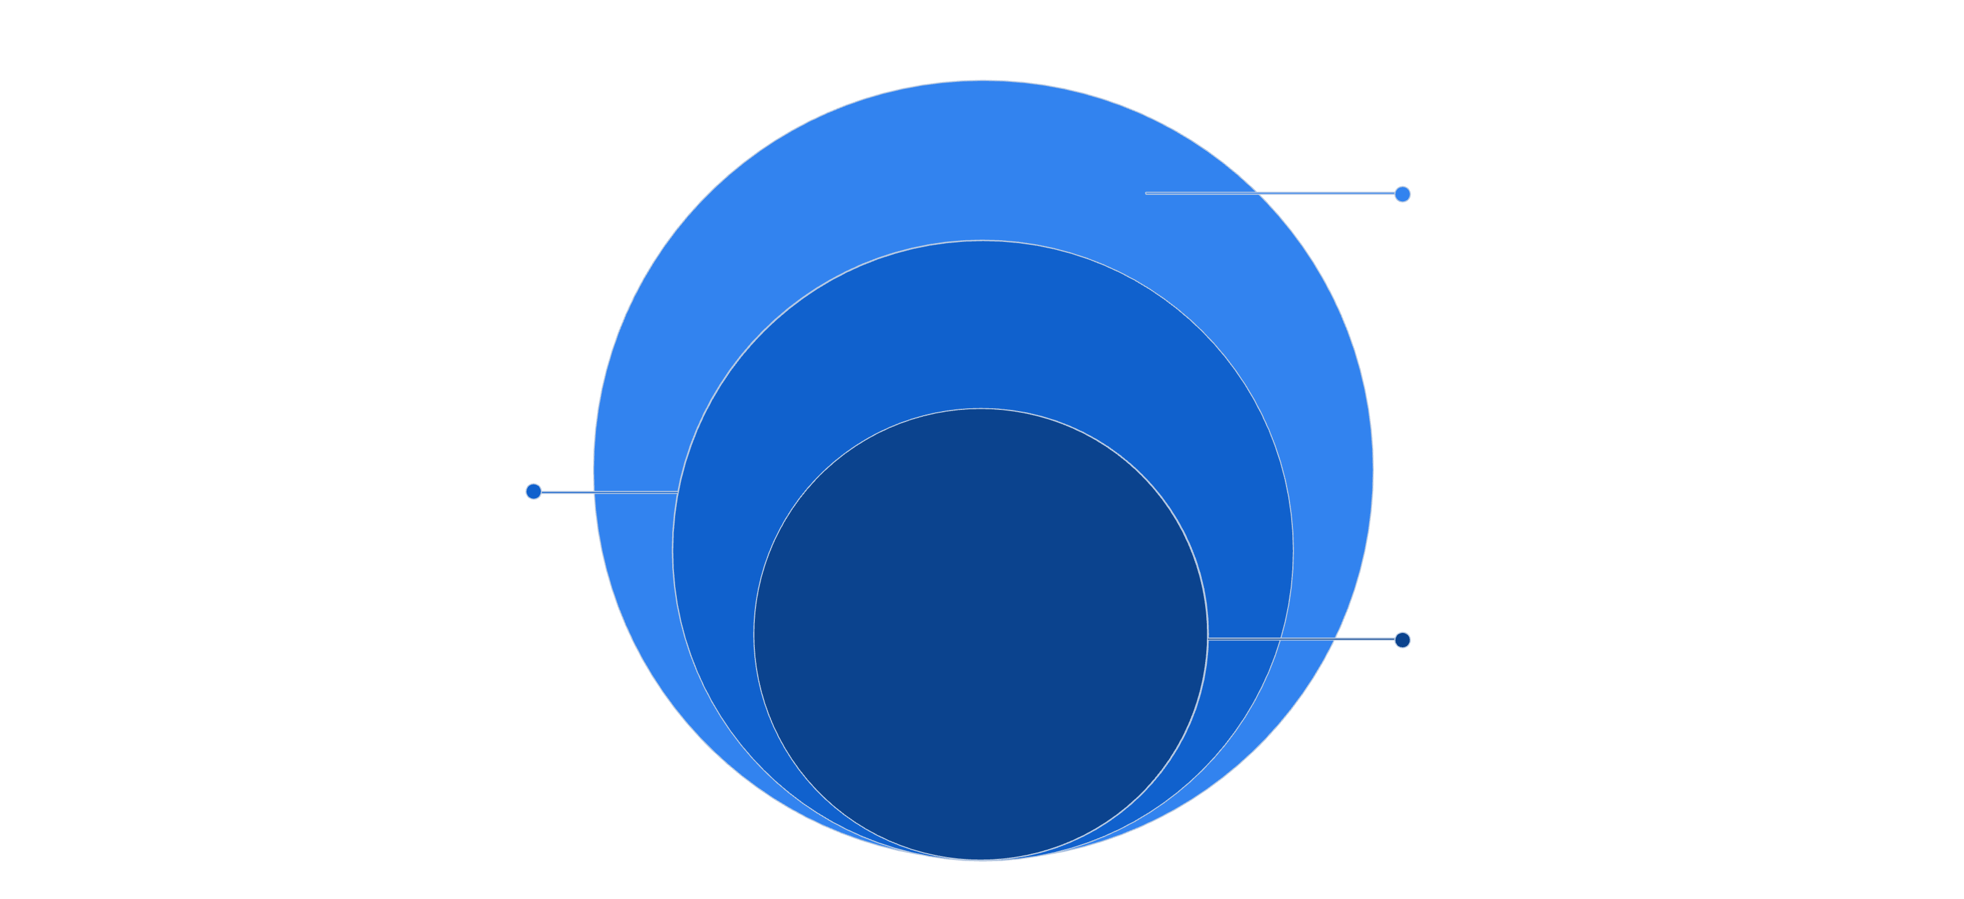
Consolidated HTC Alert Architecture
Together, these three layers establish fully automated end-to-end HTC visibility
— covering slot creation, part movement, and serial number integrity across all fleets.
XXX Serial Number Alert
HTC Part MMC Alert
Slot Creation Alert
New HT config slot created

Slide 5
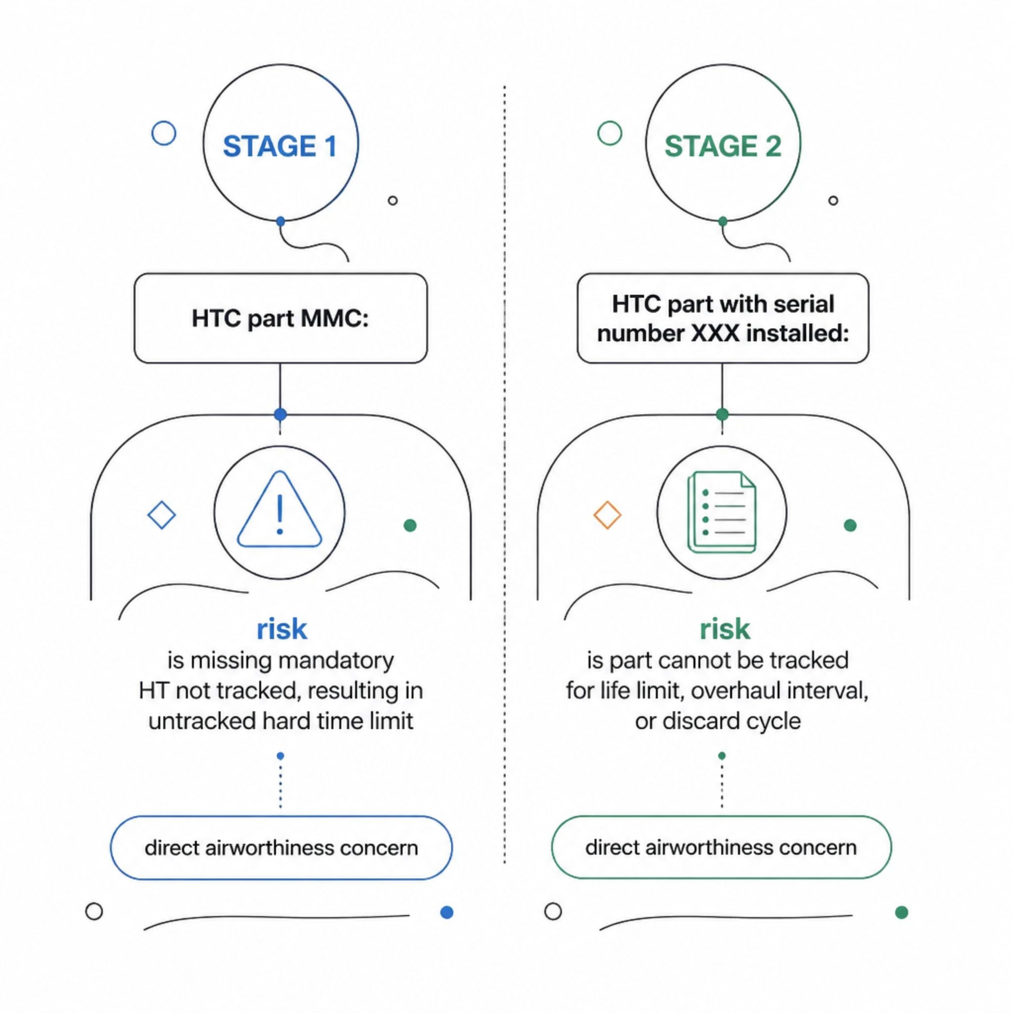
Residual Risk — Gaps Not Yet Addressed
The existing slot-creation alert
does not cover two
subsequent HTC lifecycle stages
carrying equally
high airworthiness risk.

Slide 6
Project Scope & Objectives
In Scope
Alert A: HTC MMCs — triggers from analysis of an attach/detach events
Alert B: HTC XXX S/N — triggers on placeholder serial number install
Email format, recipients, and frequency definition
MPTC&MPRC procedure updates
Objective 1
Objective 2
No HTC part MMC unnoticed >10 business day
XXX S/N flagged before next maintenance cycle
Objective 3
Eliminate manual Maintenix queries

Slide 7
Proposed Alert Details
ALERT A
ALERT B
HTC Part MMC Alert
HTC XXX Serial Number Alert
Triggers when an HTC part is detached and remained MMC for up to 10 days from any TRK-class HT config slot.
Triggers when an HTC part with S/N 'XXX' is installed on an HT config slot.
Frequency: Weekly at 08:00 EAT
Recipients: MPRC team
Action: Verify and Resolve actual S/N, update Maintenix,….
Frequency: Weekly at 08:00 EAT
Recipients: MPRC team
Action: Verify MMC HT parts, and advise respective section to take action upon.

Slide 8
Implementation Plan
W1
1
Proposal review & approval — Mgr. MPTC & MPRC
2
W2
IT technical analysis & query design
W2–3
3
Developement of the required system
4
W3–4
Testing and verifying the developed system.
W5
5
Production deployment
6
W5–6
MPRC procedure update
W10
7
30-day effectiveness review

Slide 9
Stakeholders
Solomon Alemu & Yohannes Teklegiorgis — Project owner, requirements, monitoring
Gobena Uluka— Sponsor, approver, escalation authority

